Slide 1

Object Detection
Putting it together:
YOLO algorithm
deeplearning.ai

Slide 2
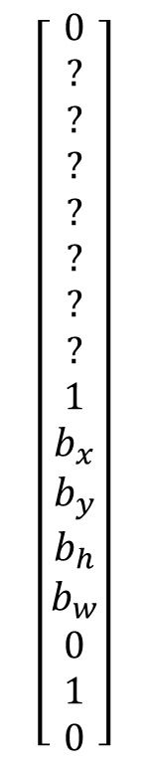
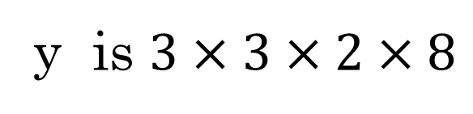
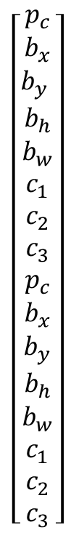
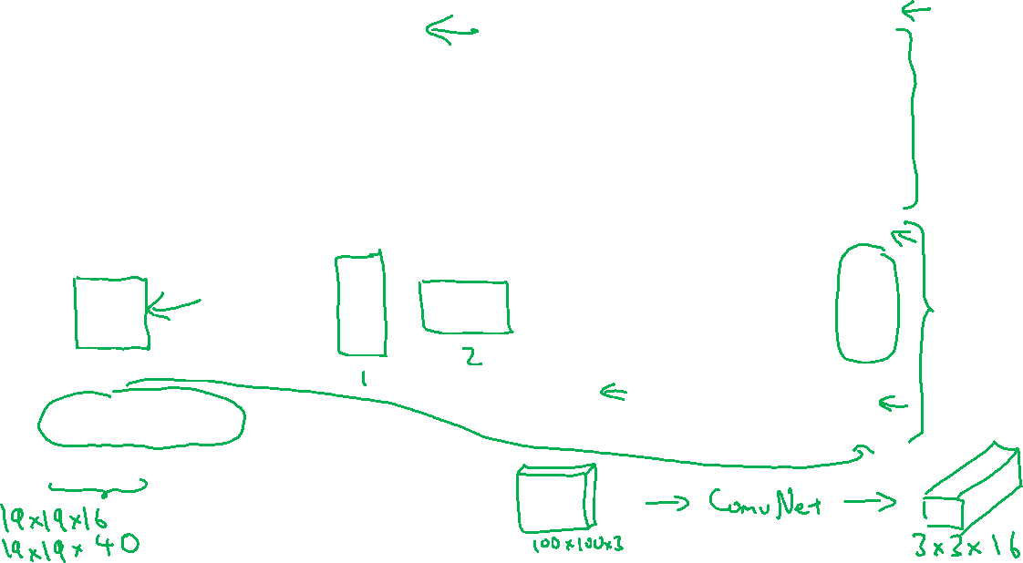
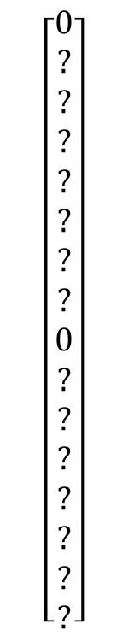
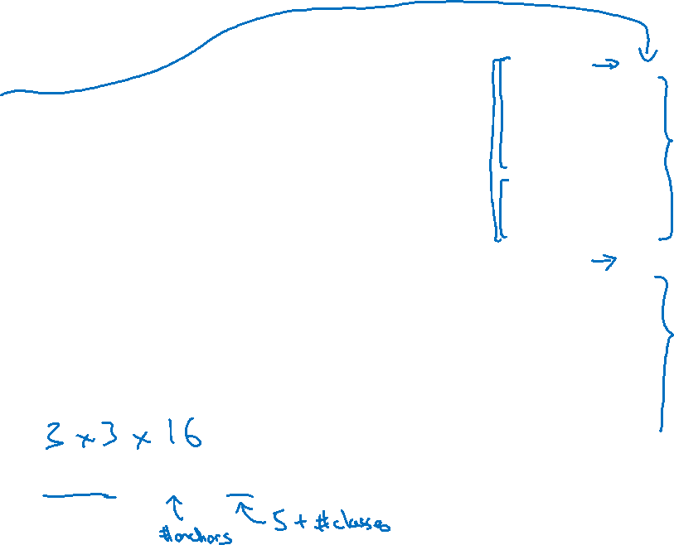
Training
1 - pedestrian
2 - car
$\left[\begin{aligned}p_{c} \\ b_{x} \\ b_{y} \\ b_{h} \\ b_{w} \\ c_{1} \\ c_{2} \\ c_{3} \\ p_{c} \\ b_{x} \\ b_{y} \\ b_{h} \\ b_{w} \\ c_{1} \\ c_{2} \\ c_{3}\end{aligned}\right]$
$$\left[\begin{aligned}0 \\ ? \\ ? \\ ? \\ ? \\ ? \\ ? \\ ? \\ 0 \\ ? \\ ? \\ ? \\ ? \\ ? \\ ? \\ ?\end{aligned}\right]$$
$$\left[\begin{aligned}0 \\ ? \\ ? \\ ? \\ ? \\ ? \\ ? \\ ? \\ 1 \\ b_{x} \\ b_{y} \\ b_{h} \\ b_{w} \\ 0 \\ 1 \\ 0\end{aligned}\right]$$
3 - motorcycle
y
=
y is $3×3×2×8$
[Redmon et al., 2015, You Only Look Once: Unified real-time object detection]

Slide 3
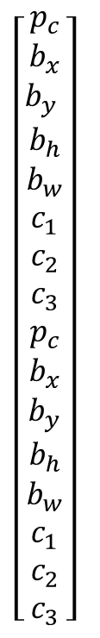

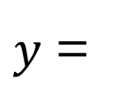

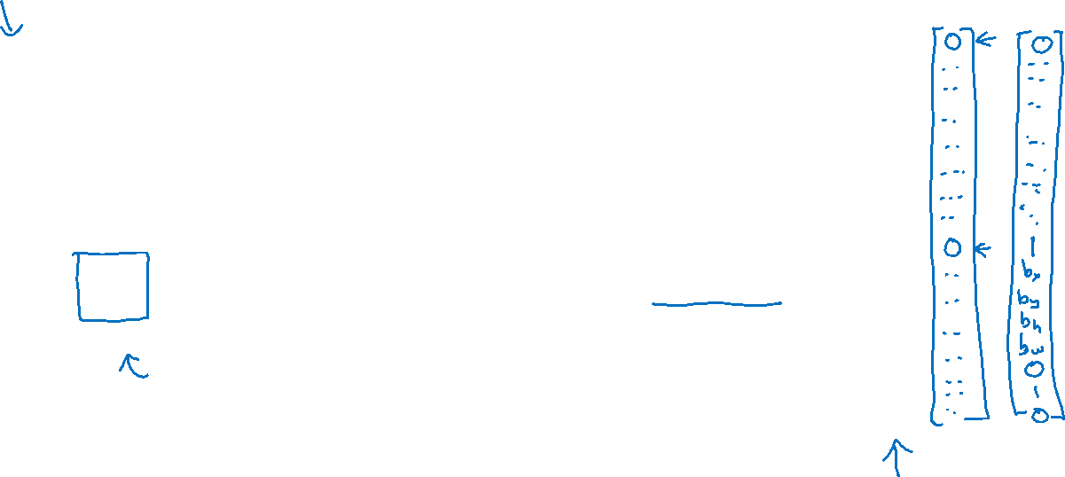
Making predictions
$\left[\begin{aligned}p_{c} \\ b_{x} \\ b_{y} \\ b_{h} \\ b_{w} \\ c_{1} \\ c_{2} \\ c_{3} \\ p_{c} \\ b_{x} \\ b_{y} \\ b_{h} \\ b_{w} \\ c_{1} \\ c_{2} \\ c_{3}\end{aligned}\right]$
$$⋯$$
$y$ =
$$3×3×2×8$$

Slide 4
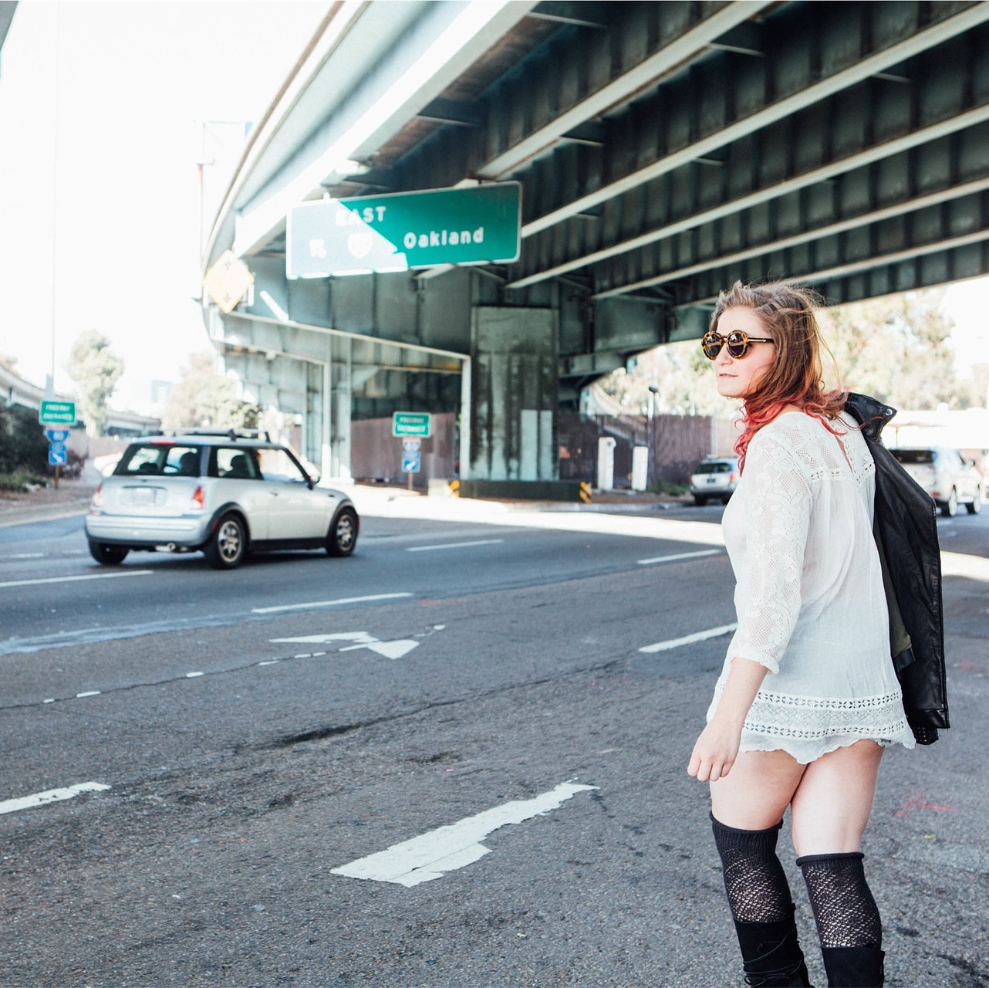
Outputting the non-max supressed outputs
For each grid call, get 2 predicted bounding boxes.
Get rid of low probability predictions.
For each class (pedestrian, car, motorcycle) use non-max suppression to generate final predictions.

